Slide 1


Slide 2
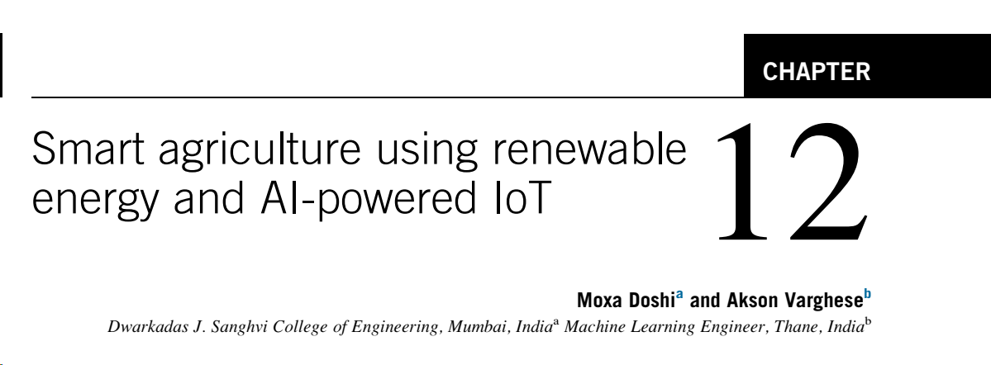

Slide 3
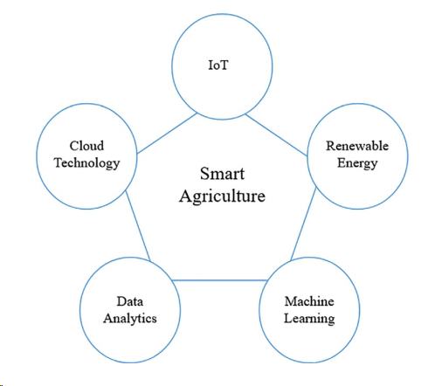
Concept Model

Slide 4
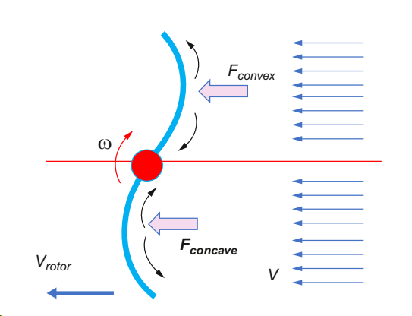
Savonius type VAWT

Slide 5
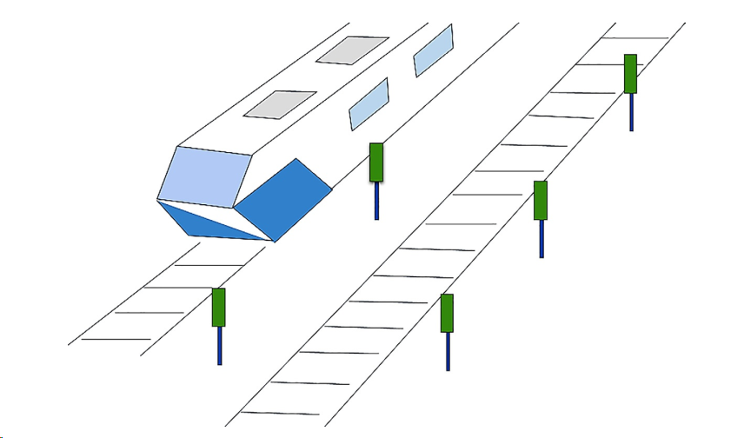
Suburban Set Up - VAWT

Slide 6
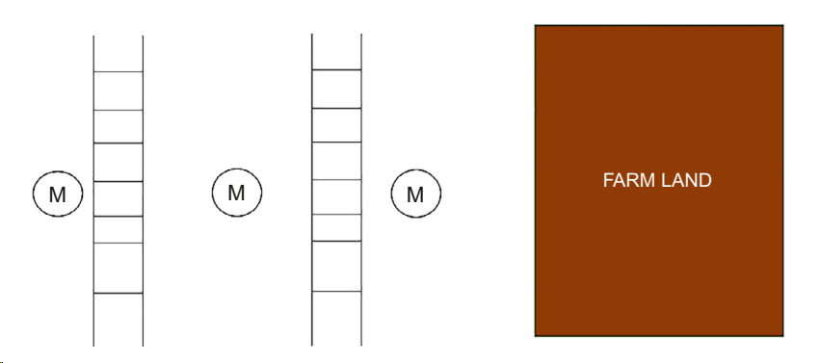
Rural Set Up - VAWT

Slide 7
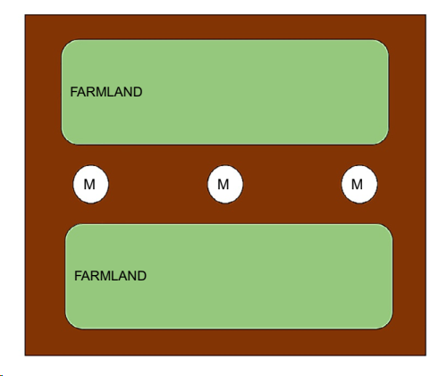
Rural Set Up - VAWT

Slide 8
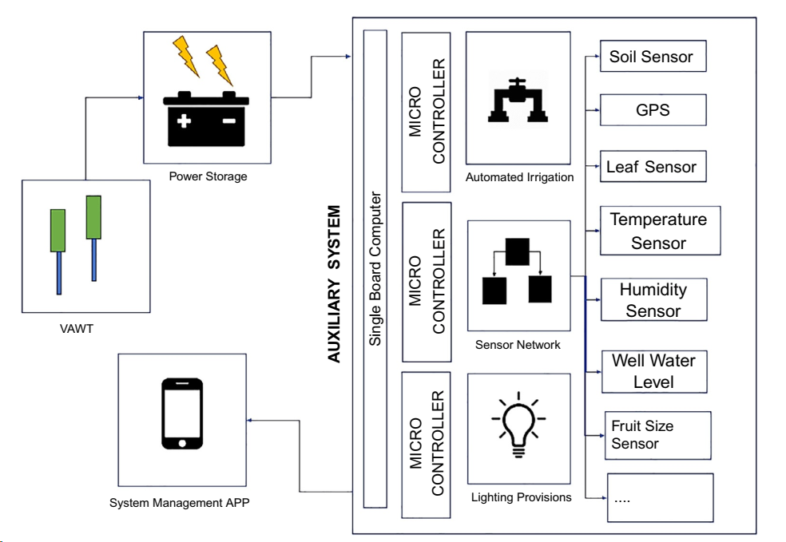
Architecture and System Design

Slide 9
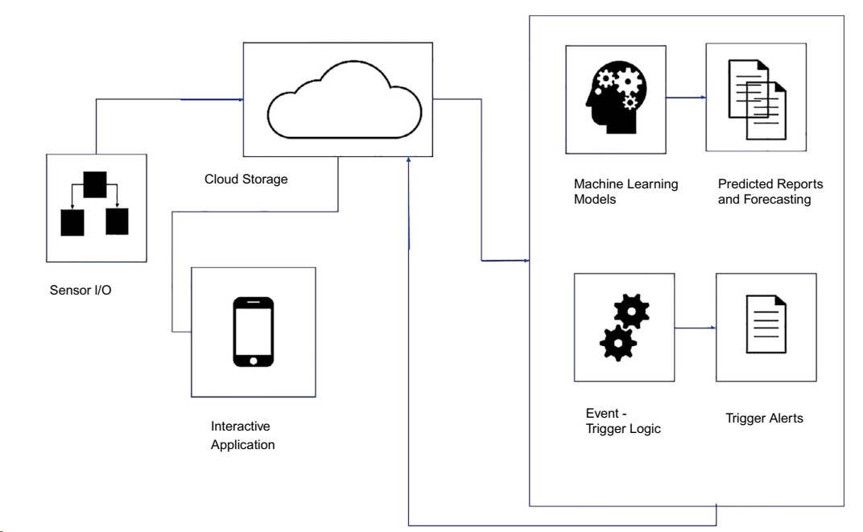
System management application

Slide 10
User Operability
Input from the user
Automation
Feedback Loops
Defaults and Preferences
Output to the user
Multilinguistic solutions

